Slide 1
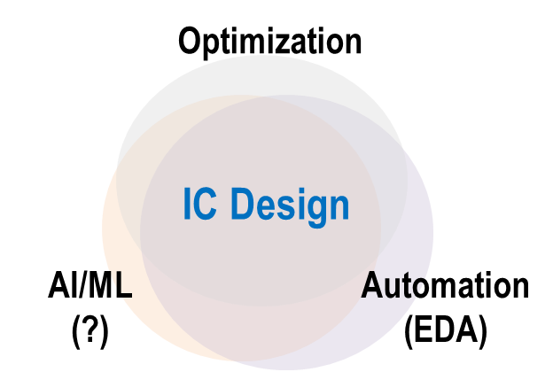
ECE 260C, Spring 2025 Andrew B. Kahng
AI and ML with OpenROAD:
Some Possibilities!
Kahng ECE 260C SP25

Slide 2
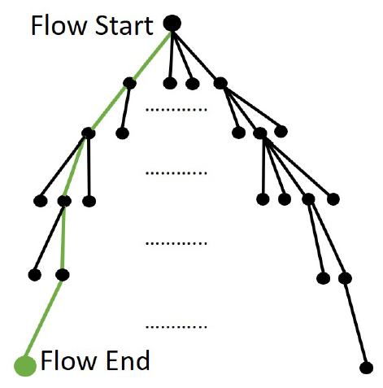
Design Optimization Lives in a Box
Start
Start to End: expensive!
O(year) for product
O(weeks) for SP&R and Opt
Goal: best possible End
Constraint: stay in “Box”
{compute}
X {licenses}
X {people}
X {weeks}
End
Designers always need more leverage!
Notes:
Here’s a cartoon of the design optimization problem.
There is an INPUT, like RTL, constraints, libraries and techfiles and so on, up HERE at the FLOW START.
Then there are many steps and decision points (like density screens or useful skew or leakage effort) on the way to a complete OUTCOME, like a routed DEF plus signoff reports, which is a FLOW END leaf.
Start to End is expensive – from weeks to months. We want the best possible END but there’s a huge space of trajectories, and
[CLICK] DESIGN must stay in a given BOX of servers, licenses, people, and weeks of schedule.

Slide 3
“Machine Learning in EDA”: Why
A. You need models to have predictions
B. You need predictions to leverage in exploration
C. What you can’t predict, you guardband
D. What you don’t explore, you leave on the table
E. C and D are bad for product quality and schedule
“Moore’s Law slowdown” → in an Era of Optimization
Notes:
TODAY, WHY do we want “Machine Learning in EDA and IC Design”? The catechism is basically:
[CLICK] You need models to have predictions
[CLICK] You need predictions that you can leverage in exploration
[CLICK] What you can’t predict, you guardband
[CLICK] What you don’t explore, you leave on the table
[CLICK] And: those last two are really bad news.
[CLICK] With the difficulty of scaling, we are well into this Era of Optimization, where we look for ML to win us QOR, schedule, and NRE cost. For ML in EDA and IC Design, there are obvious, generic directions to take ….
[CLICK] such as using ML to shift the accuracy-versus-cost tradeoff curve in your signoff analyses, and to reduce analysis miscorrelation between the creation tools side and the signoff tools side.
[[Cost of correlation vs. cost of miscorrelation ..]]

Slide 4
“Machine Learning in EDA”: What
Predict
Will RouteOpt finish with clean signoff, <1000 DRVs by tomorrow night?
Classify
Out of these 50 floorplans + budgets, which 3 should go into trial SP&R?
Estimate
How many hold buffers will tool eventually add into this post-CTS layout?
Guide / advise
What P&R tool setup/script will obtain the best QOR within next 36 hours?
More broadly: answer any question that is difficult for humans
Google Brain, 2020: “super-human macro placement” on arXiv
See: Rich Sutton, “The Bitter Lesson”
More trivially: regressions and image classifications (LSF, litho)
Notes:
WHAT Machine Learning does spans
[CLICK] Predicting (will the router finish?), and Classifying (is this floorplan and budgeting solution viable?),
[CLICK] Estimating, and Guiding – for example, what flavor of my SP&R or leakage recovery script should I run for this particular block?
[CLICK] BROADLY: ML in EDA tries to answer questions that are difficult for human experts.
Google Brain has recently claimed super-human macro placement!
AND SOMEWHAT TRIVIALLY: there’s still a lot of regression and image classification going on – putting jobs onto the right-sized servers, or looking for litho hotspots.
[[WHAT also includes your EDA enablement and your METRICS data warehouse, and what you do with it.]]
Trying to answer any question that is difficult for humans
Google Brain, 2020: “super-human macro placement” on arXiv
See: Rich Sutton, “The Bitter Lesson”
More trivially: regressions and image classifications (LSF, litho)

Slide 5
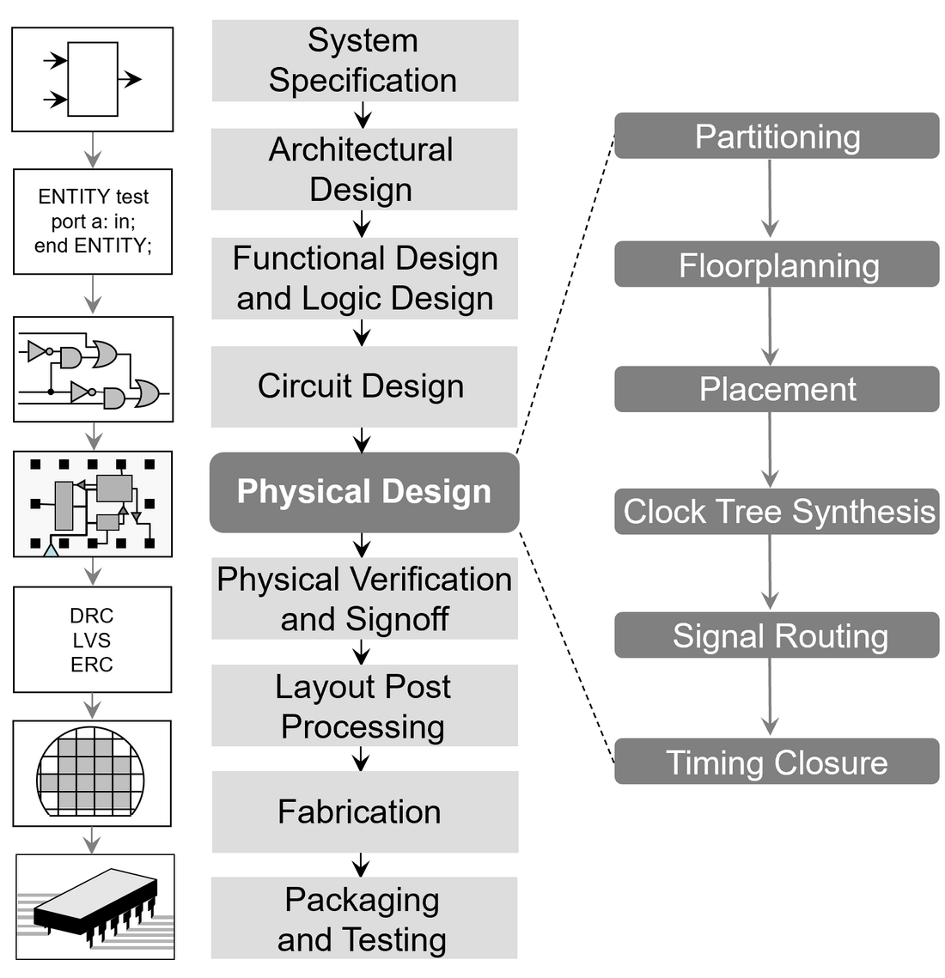
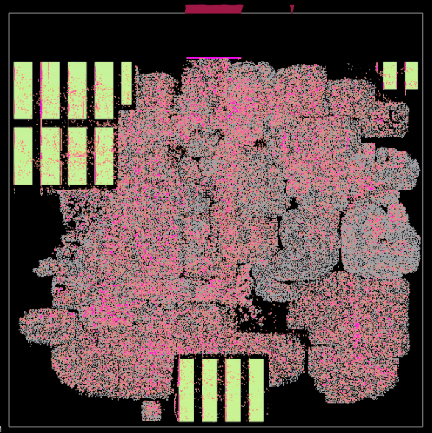
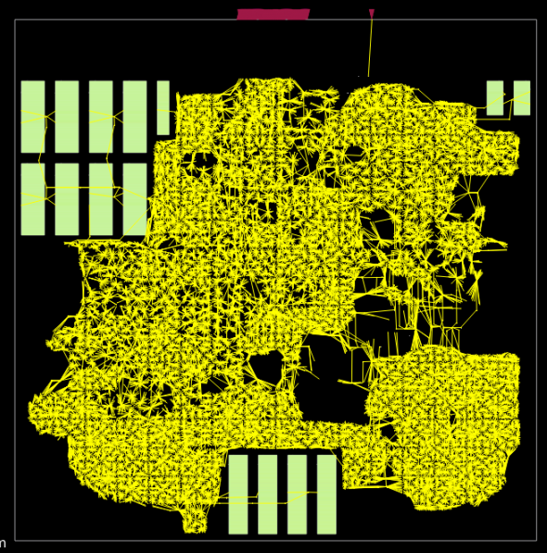
What’s Different (and Difficult) for AI/ML?
1. Changing abstractions, formats, and the design itself
LEF, DEF, .LIB, SVRF, UPF, CPM, APL, SPEF, SDC, GDS, .V, VHDL, .SP, ITF, TLU+, NXTGRD, PFM, QRCtech, SDF, CCS, LVF…
Notes:
What was “different” and “difficult” from the design process?
I’ll FIRST call out the ever-changing abstractions (text to hypergraph to embedded hypergraph), the formats, and the fact that the design is always changing, as we saw.

Slide 6
What’s Different (and Difficult) for AI/ML?
1. Changing abstractions, formats, and the design itself
2. Long chains of distinct, intractable discrete optimizations
“Practical optimization” = metaheuristics on top of metaheuristics
Scale, multimodality, dynamism, diversity → 1000s of hidden commands and options in a commercial placer !
Objectives are ad hoc
Trajectories are chaotic
Outcomes have distributions
LEF, DEF, .LIB, SVRF, UPF, CPM, APL, SPEF, SDC, GDS, .V, VHDL, .SP, ITF, TLU+, NXTGRD, PFM, QRCtech, SDF, CCS, LVF…
Notes:
SECOND, there’s this long “chain” of distinct, NP-hard discrete optimizations – metaheuristics stacked on top of metaheuristics, as problems get bigger and harder but customers still want the tool to run overnight. And all their products and their foundries are different – so commercial EDA tools have tens of thousands of hidden commands and options !!!
What’s the right cost function when your tool is in the middle of the tool chain?
So, objectives are ad hoc, trajectories are chaotic, and outcomes have distributions …

Slide 7
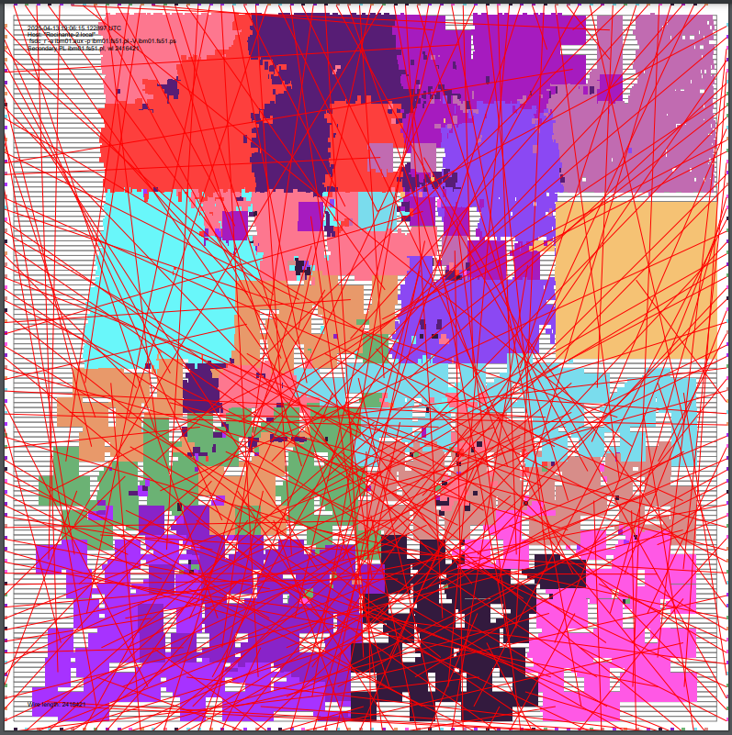
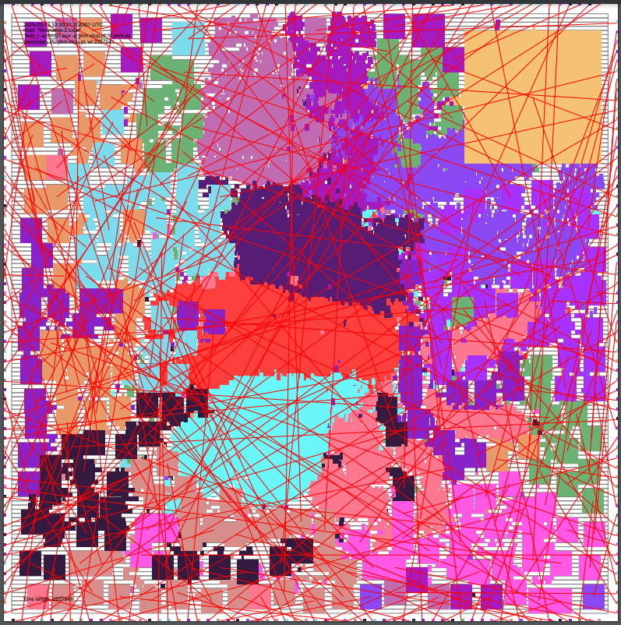
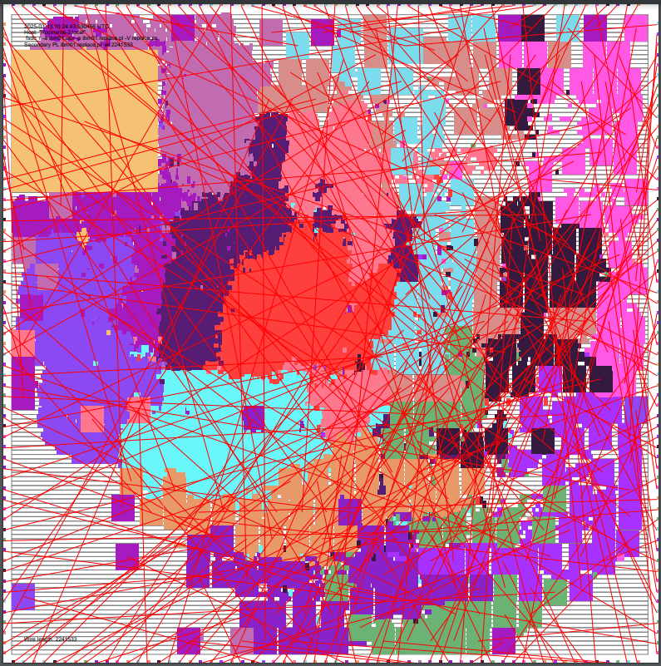
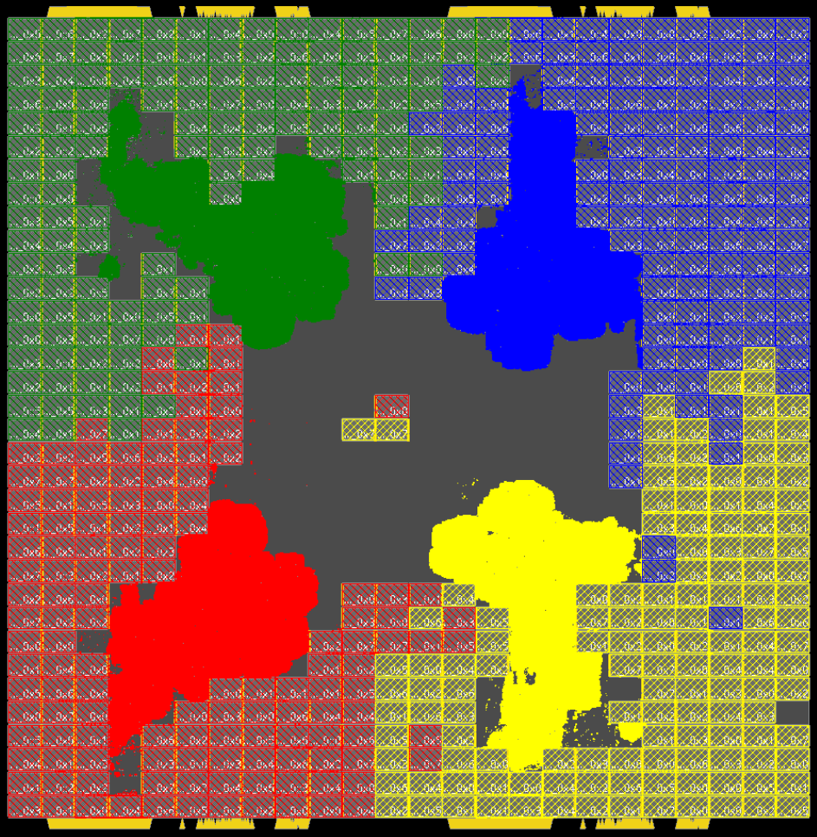
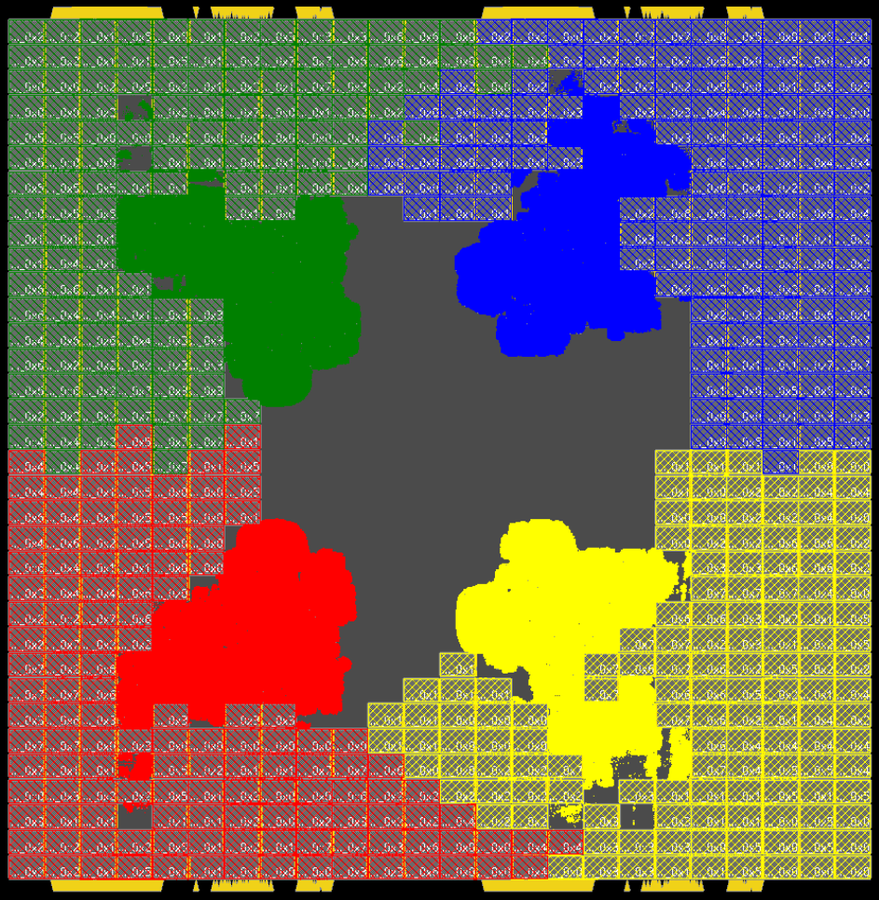
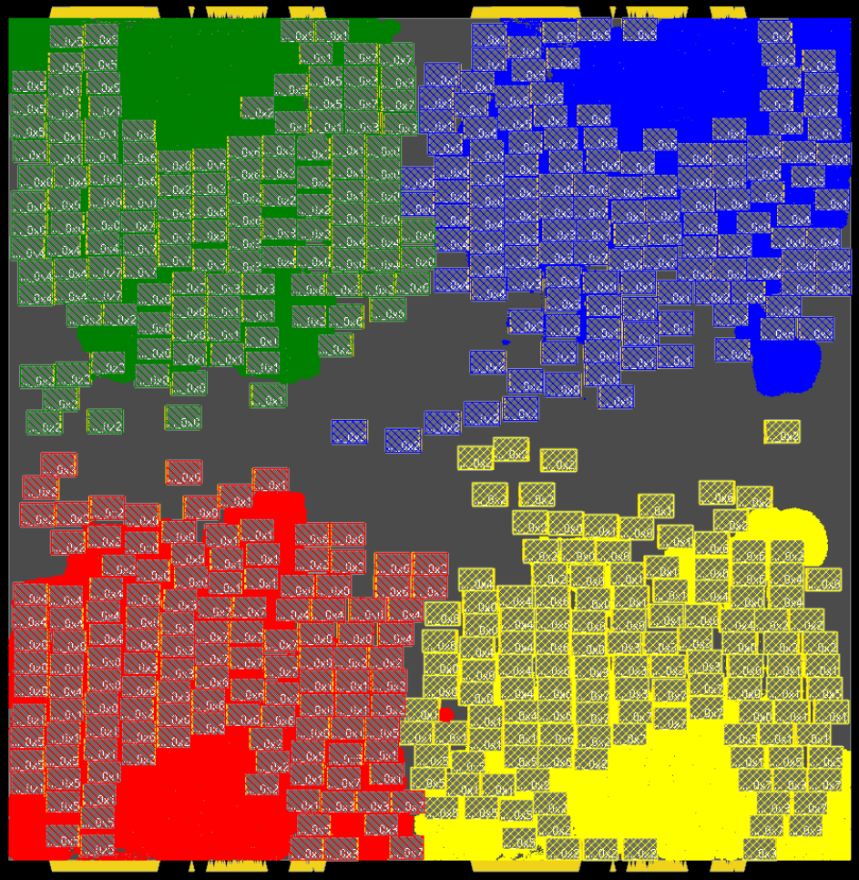
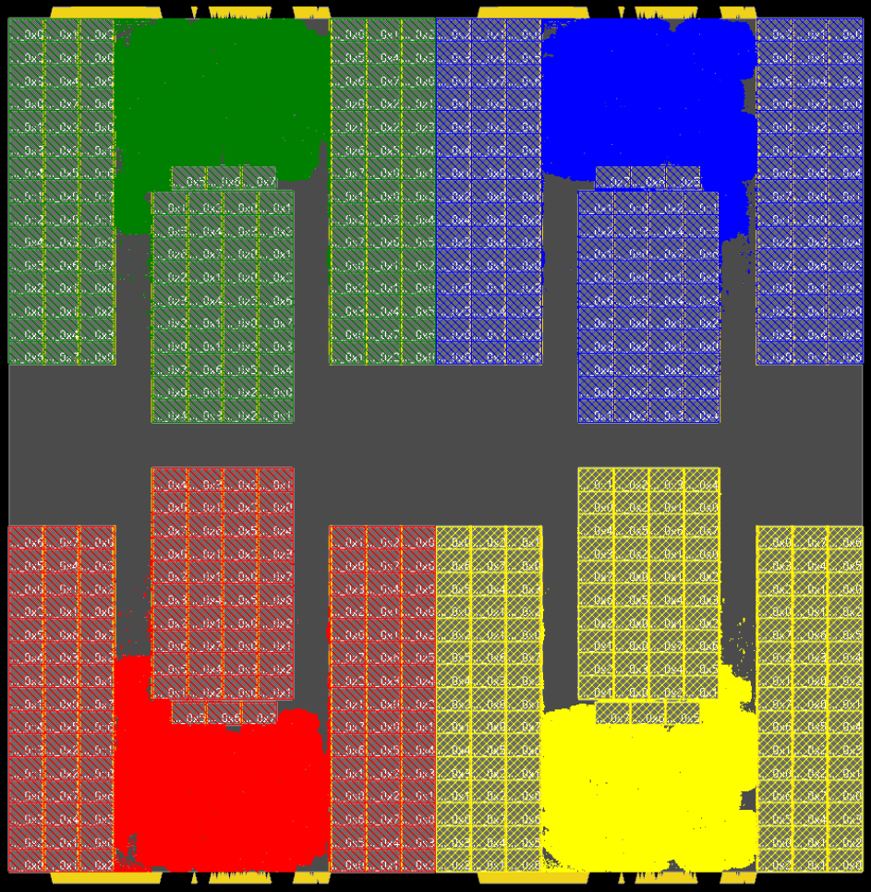
Outcomes Heavily Mediated by Heuristics!
FengShui5.1
NTUplace3
RePlAce
“ibm01” from ISPD-2002, “Bookshelf” format
12.7K instances
FengShui ~2005; NTUplace3 ~2008; RePlAce ~2018
“CT-Ariane133 X4”, protobuf format [link]
532 macros, 332K cells in TSMC 7nm
AlphaChip 2024, SA/GWTW 1983/1994; RePlAce 2020-
AlphaChip
SA + “GWTW”
RePlAce (OpenROAD)
Human
“ibm01” thanks: Prof. Patrick Madden, Binghamton Univ.
Notes:
which are HEAVILY mediated by whatever heuristics are in these optimizers !!!
[CLICK] Here’s an old testcase with 12 thousand movable objects. Three placement heuristics here span almost 15 years – the one on the right is the electrostatics-based one I showed a few minutes ago. What logic synthesis optimizer should be run before, and which router should be run after, each of these?
[CLICK] Here are four “macro placement” solutions for a Google example copied four times. This picture spans 40 years of optimization heuristics – and all four methods are in use today!

Slide 8
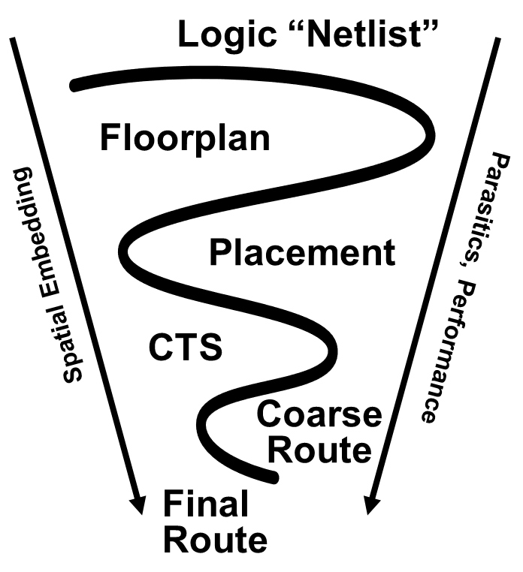
What’s Different (and Difficult) for AI/ML?
1. Changing abstractions, formats, and the design itself
2. Long chains of distinct, intractable discrete optimizations
“Practical optimization” = metaheuristics on top of metaheuristics
Scale, multimodality, dynamism, diversity → 1000s of hidden commands and options in a commercial placer !
Objectives are ad hoc
Trajectories are chaotic
Outcomes have distributions
3. Loops are expensive (often, fatally so)
Design process must “converge” both spatial embedding and performance
LEF, DEF, .LIB, SVRF, UPF, CPM, APL, SPEF, SDC, GDS, .V, VHDL, .SP, ITF, TLU+, NXTGRD, PFM, QRCtech, SDF, CCS, LVF…
How?
Notes:
Third, loops are expensive! So the design process must converge BOTH the performance and the spatial embedding of the chip’s logic – from crude estimates of parasitics, timing and power starting on top, to exact values after final routing at the bottom.
[CLICK] HOW does this magic happen?

Slide 9
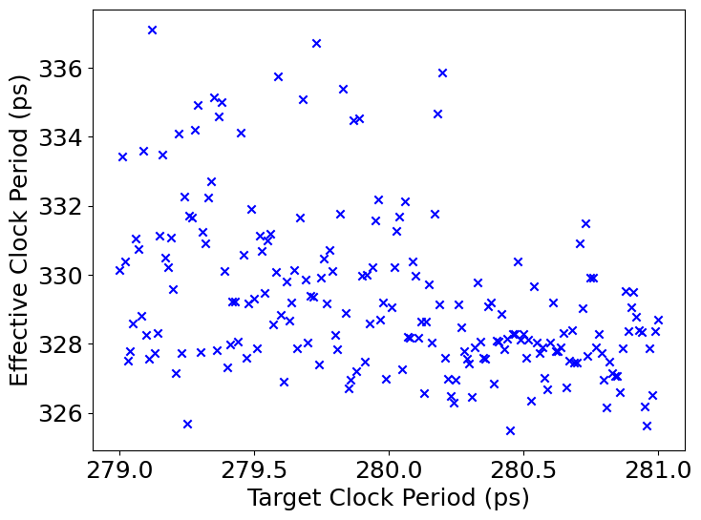
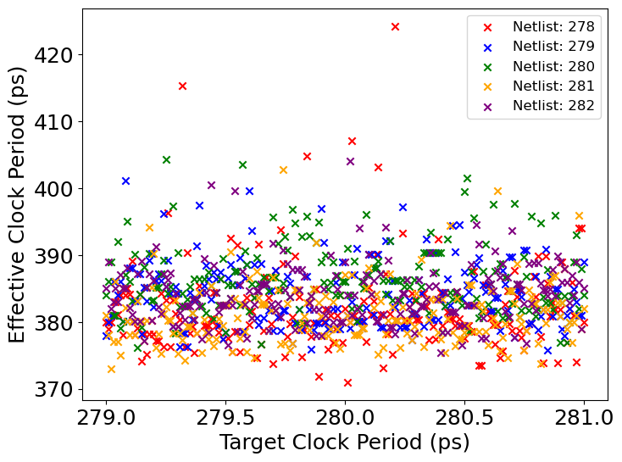
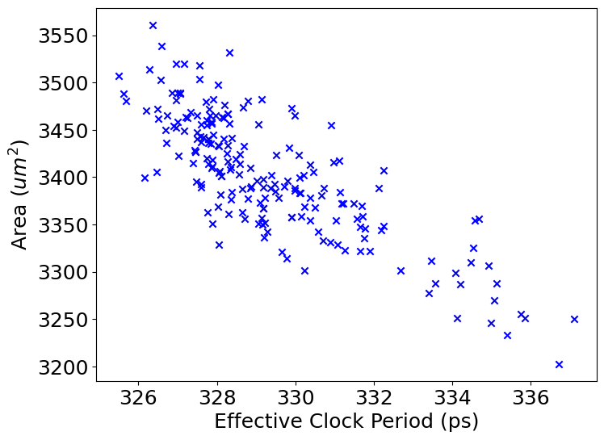
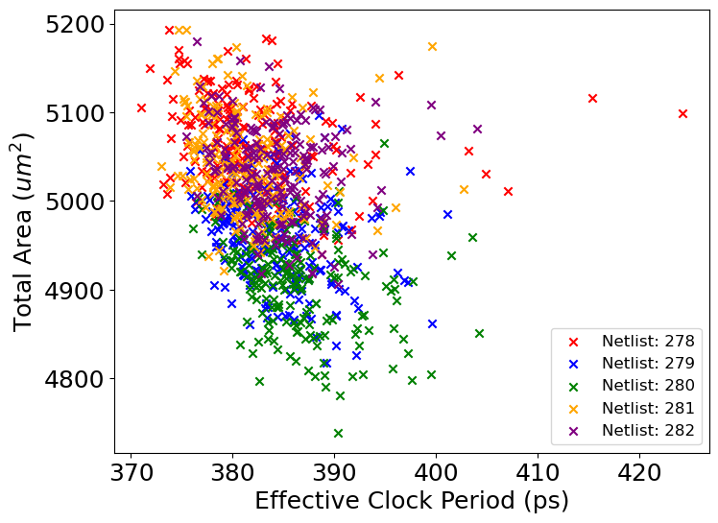
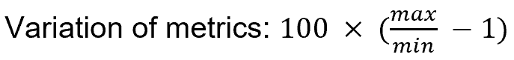
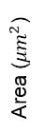
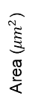
With Chained Chaotic Optimizations ?!?
3.4% Variation of Effective Clock Period
15% Variation of Effective Clock Period
Effective Clock Period (ps)
Effective Clock Period (ps)
Logic Synth
Place & Route
Target Clock Period (ps)
Target Clock Period (ps)
11% Variation of Total Cell Area
9% Variation of Total Cell Area
Area ($μm^{2}$)
Area ($μm^{2}$)
Effective Clock Period (ps)
Effective Clock Period (ps)
Notes:
Well, somehow, convergence is achieved with a chain of essentially chaotic optimizers. You change initial conditions or constraints by a smidge, and results change dramatically – which is “chaos” [or, “unreliability”]. And when you ask a tool to hit a target, you get a distribution of outcomes somewhere else.
Here a logic synthesis tool is asked 201 times to hit a 280ps clock period target, which is around 357 MHz.
The tool reports that the Boolean logic networks it produces run at around 300 MHz.
[CLICK] If I push the place-and-route button 1000 times, the results run at between 230 and 270 MHz, with a whole technology node’s worth of variation – [CLICK] pretty far from what the previous tool in the tool chain led me to expect.

Slide 10
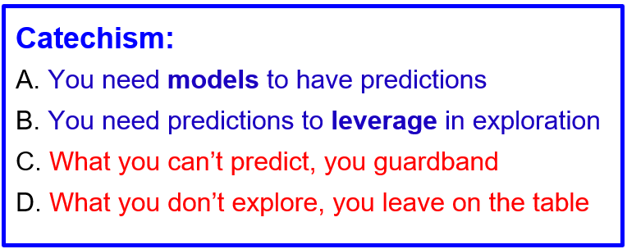
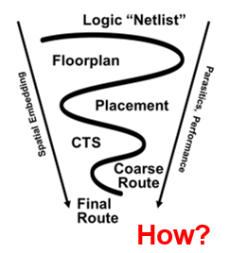
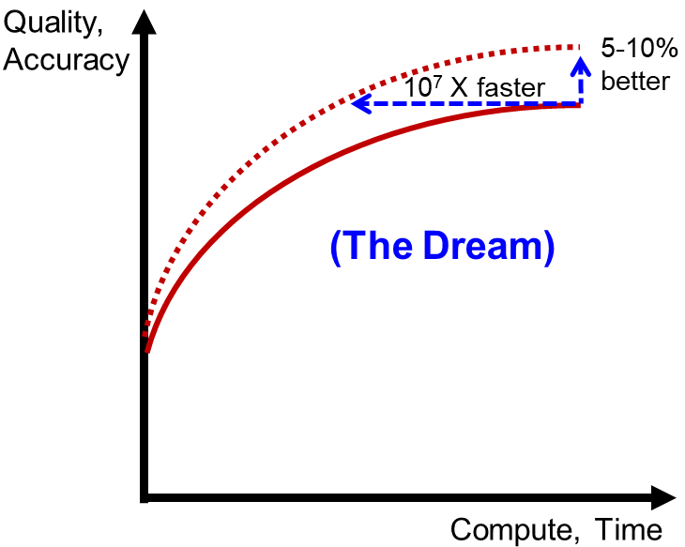
Implications for Optimization in IC Design
Predictions today are Constructive
Quick-and-dirty, under the hood
Optimizations today are Iterative
“Construct by Correction”
Need Fast Simulations to guide Optimization
“Construct by Corrections … … that are Correct by Construction”
AI and ML to the rescue?
Notes:
What does this imply for optimization in IC design?
[CLICK] We need predictions for leverage in exploration. But how can you predict an optimizer that behaves so chaotically, let alone a chain of these? [CLICK] The answer is constructive prediction – we predict by doing, quick and dirty, under the hood.
[CLICK] And how does this convergent EDA magic happen? [CLICK] The answer is “construct by correction”, meaning that optimization is one long tweak, analyze-tweak-analyze iterative improvement loop.
[CLICK] Which is where surrogate or compact models and [CLICK] fast PDE solvers come in – we hope they’ll help us shift the accuracy-runtime tradeoff up and to the left! [CLICK] We want to construct with corrections that are more accurate – and we want to make more iterations.

Slide 11
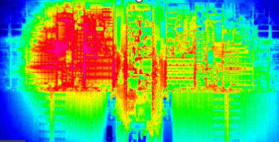
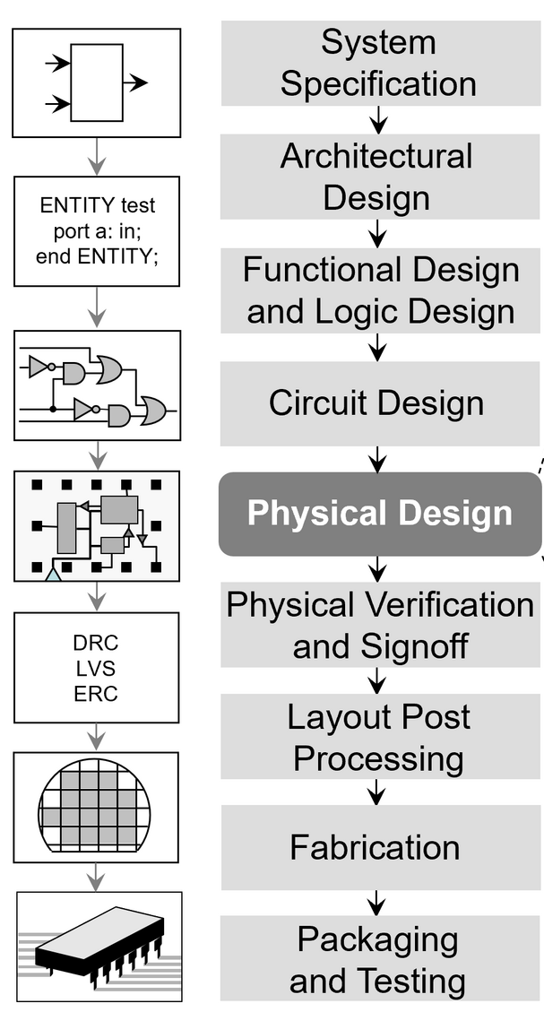
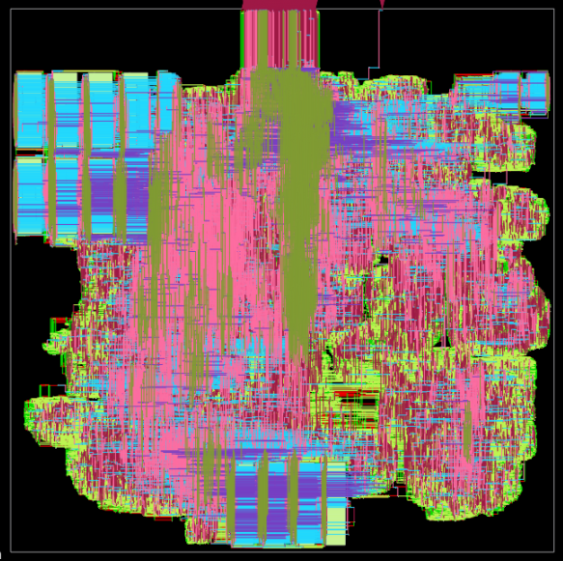
Signoff in Design: Optimize Max, not Sum!
Signoff is a defined business interface
Establishes “Who pays for the scrap?”
Golden, foundry-qualified tools perform signoff analyses and simulations
Typically with very long batch runtimes
Many design steps must optimize “max”
Max timing path delay determines max frequency
Max wiring congestion determines routing feasibility
Inverse problems galore
Worst-case stimuli → e.g., “rogue wave in power grid”
“Whack-a-mole”, “ping-pong” are in the lexicon of design → can new AI foundation models help?
Notes:
One last note is about “signoff” – which is a business interface that defines who’s responsible for a chip that doesn’t meet spec”. [Who pays for the scrap?] Qualified signoff tools are slow and they run in batch mode – not inside tight optimization loops. So [CLICK] the design optimization is often about MAX values: [CLICK] across ALL those temperature and current and stress maps at every clock tick, the MAX timing path delay determines whether the chip meets the timing spec. (No MAPEs here.)
[CLICK] And layouts have that infinite variation because the MAX congestion hotspot determines whether the router fails – and both placer and router try to avoid such failures.
[CLICK] There are many inverse problems, like, what activity pattern induces the IR drop map that induces the MAX timing. And, when you minimize the MAX you’re often playing a whack-a-mole game – fixing one timing path makes another path pop up, and so on.

Slide 12
4-Stage “Roadmap” of ML in EDA
Mechanization and Automation
Orchestration of Search and Optimization
Pruning via Predictors and Models
From Reinforcement Learning through Intelligence
Huge space of tool, command, option trajectories through design flow
Kahng ECE 260C SP25
Notes:
The fourth stage – and please understand this is a pretty old slide – is everything else. From Reinforcement Learning through Intelligence.
[CLICK] Early last year, folks from Cadence and Qualcomm joined me in giving this tutorial at ASP-DAC – and the link is here. ML in EDA has moved quite fast since then.

Slide 13
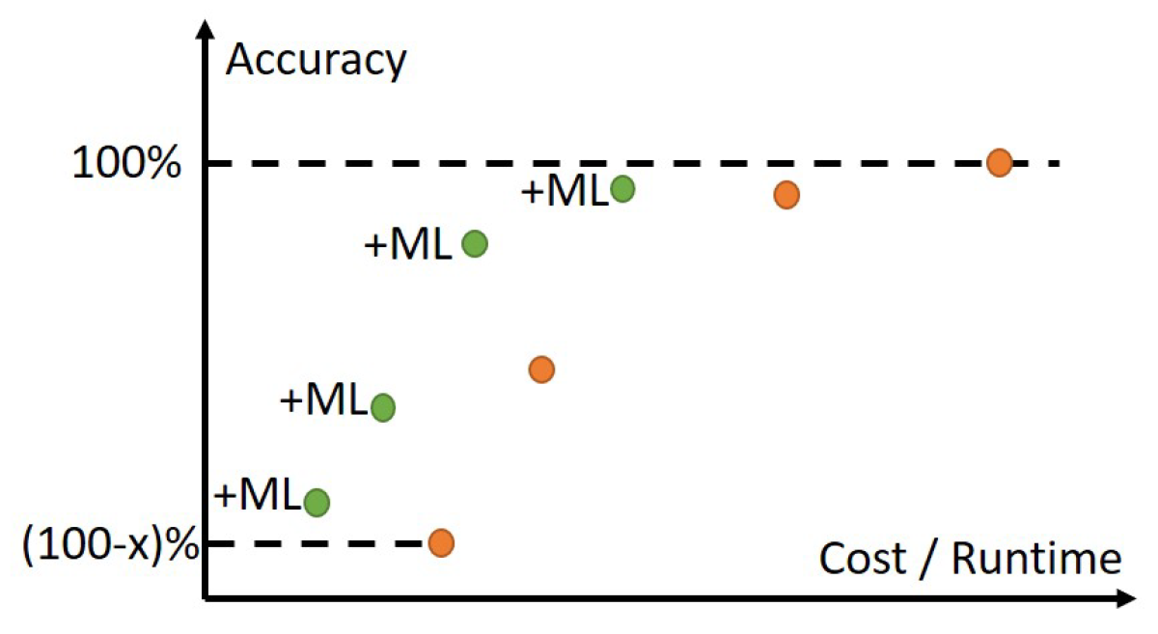
No-Brainer: Shift Accuracy-Cost Tradeoffs
Tagline: “It’s Just Physics!”
Kahng ECE 260C SP25
Notes:
The ORANGE dots show the traditional COST (X-axis) versus ACCURACY (Y-axis) tradeoff curve, as we go from 3D field solvers at the top right to piecewise analytic models to first-order estimates, etc. Very smart design methodologists, DTCO folks, library teams, signoff teams, design engineers all figure out how to pick and choose from the orange points during IC design.
What we have been working on for a number of years is how to create Machine Learning-based GREEN tradeoff points: essentially, getting off the ORANGE curve and gaining accuracy for FREE.
The bigger the “x” is in the range of orange dots, the bigger the potential benefit …

Slide 14
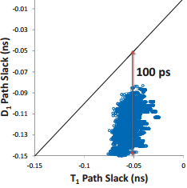
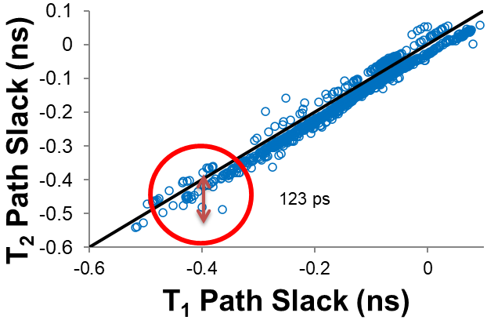
ML to Fix Timing Miscorrelation
UCSD, DATE-2014
D = non-signoff timer (e.g., in P&R tool)
T = “golden” timer (e.g., signoff-qualified)
Can you explain the slack miscorrelation?
What is the impact of the miscorrelation?
Kahng ECE 260C SP25
Notes:
Miscorrelation in the design flow means guardbands and non-convergence, which costs you time, quality and money. These are plots of endpoint slacks from a P&R tool versus a golden timer, and one vendor’s timer versus another vendor’s timer. The discrepancies are multiple stage delays!
When your golden timer T-ONE costs $200K a copy, signing off on dozens of blocks at hundreds of mode-corner combinations is expensive. You can’t use a cheaper T-TWO timer, or the P&R tool’s timer, because miscorrelation costs you quality and schedule. But imagine if there was a magic utility that could turn a timing report from the cheap timer or the P&R timer -- into a timing report from the golden tool. This is what we developed around four years ago.

Slide 15
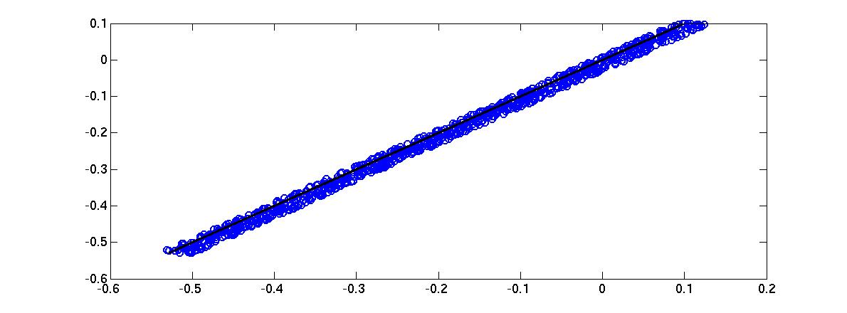
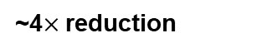
“gt1-gt2”: ML to Erase Miscorrelation
Can also erase miscorrelation between D, T
Outliers
(data points)
INCREMENTAL
If error > threshold
New
Designs
Train
Validate
MODELS
(Path slack, setup time, stage, cell, wire delays)
Test
Artificial
Circuits
Real
Designs
ONE-TIME
BEFORE
AFTER
T₂ Path Slack (ns)
ML Modeling
31 ps
123 ps
T₁ Path Slack (ns)
Kahng ECE 260C SP25
Notes:
Our flow first trains models using timing data obtained from small artificial circuits.
We validate the models using data from artificial circuits as well as real designs to minimize both mean-squared error and range of errors.
We test the models using real design data. The flow in the blue dotted box is a one-time effort.
A new design taped out in the same technology might have cells and wiring configurations that are out of scope for the current fitted models. These might introduce divergence in timing reports. So, we use data from new designs to test the existing models, and if error is above a threshold, we bring in these datapoints to refine our models. This “incremental modeling” flow is shown by the red-dotted box.
The end result – FOUR X reduction in timer miscorrelation – is shown in the bottom plots.
Parameter list:
(i) incremental delay in non-SI mode; (ii) transition time in non-SI mode; (iii) clock period; (iv) resistance; (v) coupling capacitance; (vi) ratio of coupling-to-total capacitance; (vii) toggle rate; (viii) number of aggressors; (ix) ratio of the stage in which the arc of the victim net appears to the total number of stages in the path; (x) logical effort of the net’s driver; and (xi), (xii) the differences in max (respectively, min) arrival times1 of the signal at the driver’s output pin for the victim and its strongest aggressor.2

Slide 16
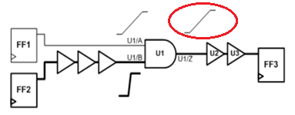
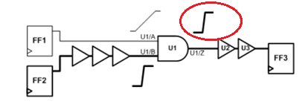
Predicting PBA from GBA
UCSD, ICCD18
PBA (Path-Based Analysis) is less pessimistic but more expensive than GBA (Graph-Based Analysis)
ML to predict PBA timing from GBA timing
→ Better and faster outcomes from P&R, Opt
GBA Mode
PBA Mode
Kahng ECE 260C SP25
Notes:
One next step we’re working on: predicting expensive path-based analysis from cheaper graph-based analysis. As shown here, GBA propagates worst slews that might not apply to a given specific path. PBA eliminates this pessimism. This is the distribution of PBA slack – GBA slack for NETCARD in 28nm – the GBA pessimism can be more than a stage delay.
The MACHINE LEARNING question: CAN WE PREDICT PBA TIMING FROM GBA TIMING?

Slide 17
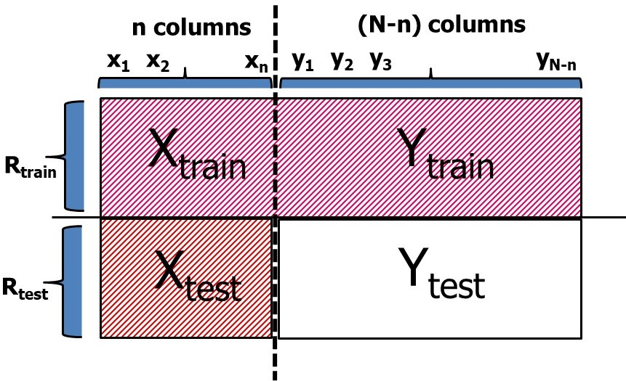
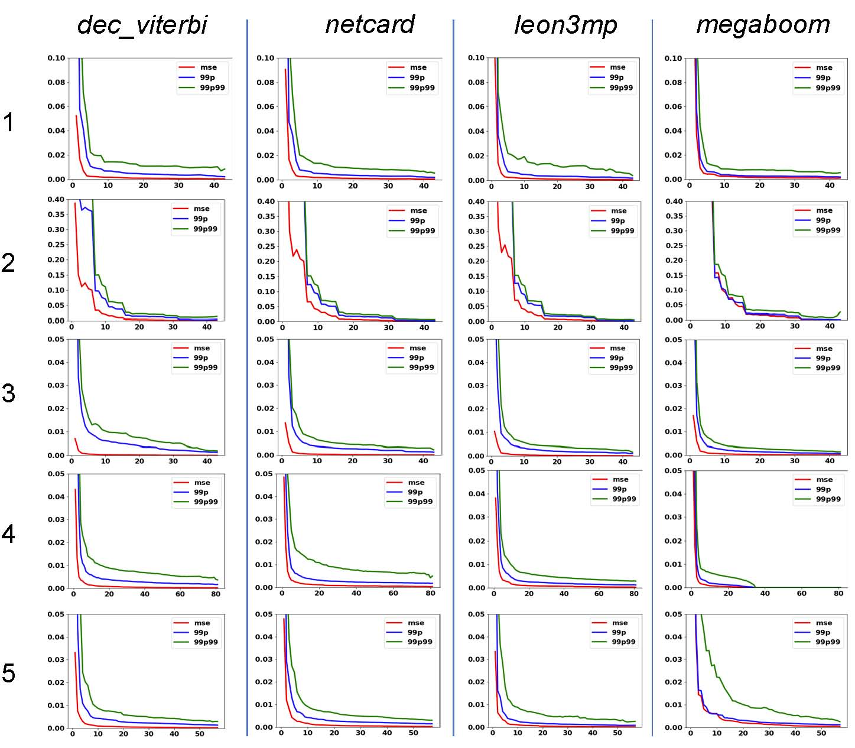
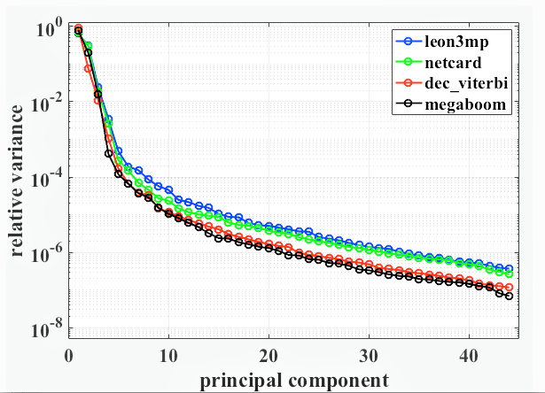
Timing at “Unobserved Corners”
UCSD, DATE19
Predicting missing delay values = matrix completion problem
STA at few known corners → predict timing at all unknown corners
PCA: low-dimensional modeling task
“It’s Just Physics!”
Kahng ECE 260C SP25
Notes:
So, predicting those missing RED delay values is the problem of predicting Y_Test in this picture. CLICK. It is a classic ML problem: Matrix Completion.
CLICK. And, something that is not surprising when we realize this is physics of signal propagation in devices and wires – ‘Relative Variance’ captured by successive principal components shows support is concentrated in a low-dimensional subspace.
CLICK. So the industry is basically going to use machine learning to (A) find the most useful say DOZEN corners to analyze, and then (B) predict the timer’s results for the remaining hundreds of other corners.
CLICK. Our paper used studies in 28 and 16nm foundry nodes to show that STA at relatively few KNOWN corners enables accurate prediction of timing at all UNKNOWN corners – especially in realistic “DESIGN-DEPENDENT” contexts where a given block will go through SP&R many times during the design process – we keep on learning and improving this kind of model.

Slide 18
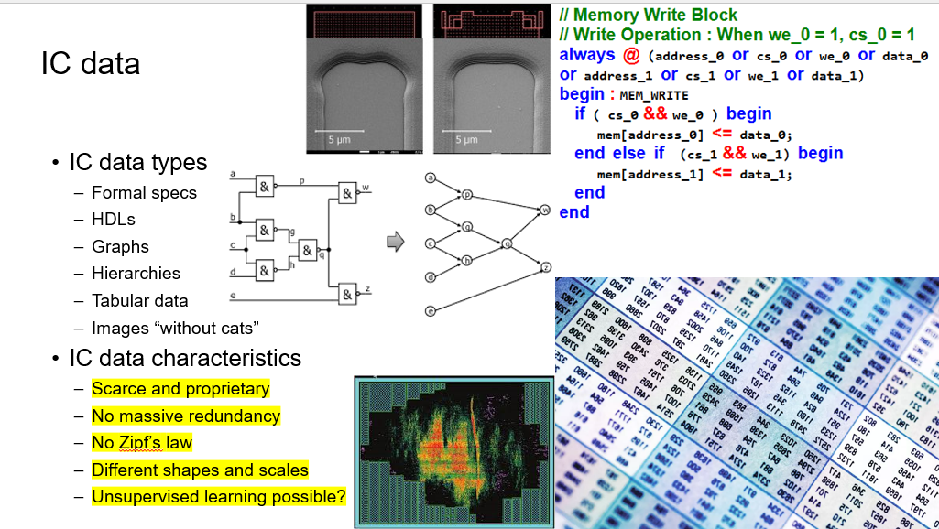
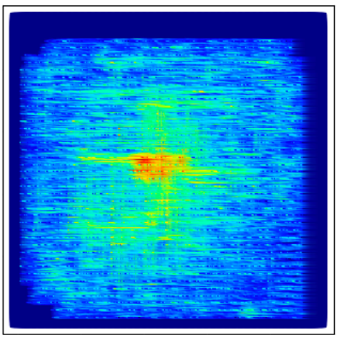
A Call-Out: Semiconductor Design Data
Many types
Formal specs
HDLs
Graphs
Hierarchies
Tabular data
Images
IC data characteristics
Constantly changing
technologies, designs, tools, …
Non-standard forms (even, “Tower of Babel”)
No massive redundancy
Different shapes and scales
No “Zipf’s Law”
Is unsupervised learning even possible?
Who owns, and who can use, what data?
Thanks: Igor Markov, Synopsys
Notes:
Physics is universal, but IC design data isn’t: Formal specs, rare languages, graphs and hypergraphs, hierarchies, tabular data, images … multimodal and sparse, to say the least.
Then, [CLICK] it is constantly changing – with an intentional “Tower of Babel” nature. There’s no redundancy. No “Zipf’s Law”. [CLICK] Is unsupervised learning possible? [CLICK] Who owns, or can use, what data!

Slide 19
A Call-Out: Semiconductor Design Data
Proprietary
Designs
Technologies
Design methods
EDA tools
Expensive
E.g., design flows take weeks to run
Closer to physics → harder to access
Materials
Equipment
Process, Devices
…
Notes:
Well, obviously, IC data tends to be proprietary, [CLICK] it’s very expensive – you need weeks to produce a result using millions of dollars of tool licenses – and [CLICK] the closer you get to materials, equipment, process recipes, SPICE models, measured data … access get harder.

Slide 20
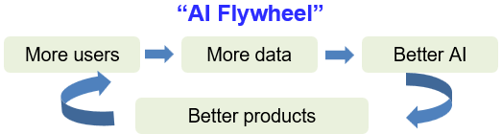
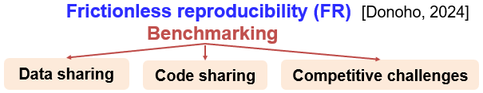
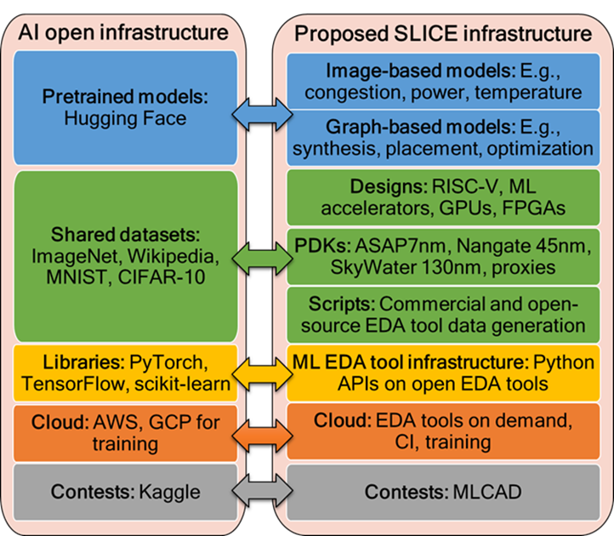
Semiconductor Design Data: Well-Lamented Gaps
Proprietary
Designs
Technologies
Design methods
EDA tools
Expensive
E.g., design flows take weeks to run
Closer to physics → harder to access
Materials
Equipment
Process, Devices
…
https://slice-ml-eda.github.io/
Notes:
So in chip design automation, [CLICK] we don’t have an AI Flywheel, [CLICK] there is no Frictionless Reproducibility, and [CLICK] counterparts of Hugging Face or ImageNet or Kaggle in the EDA and IC design universe are still aspirations. (The mapping and infrastructure shown here, called “SLICE”, is something I’ve been part of.)

Slide 21
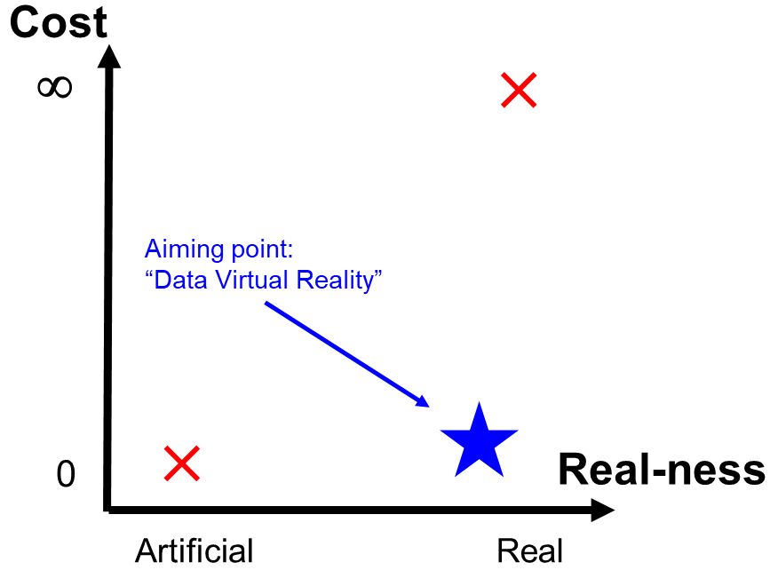
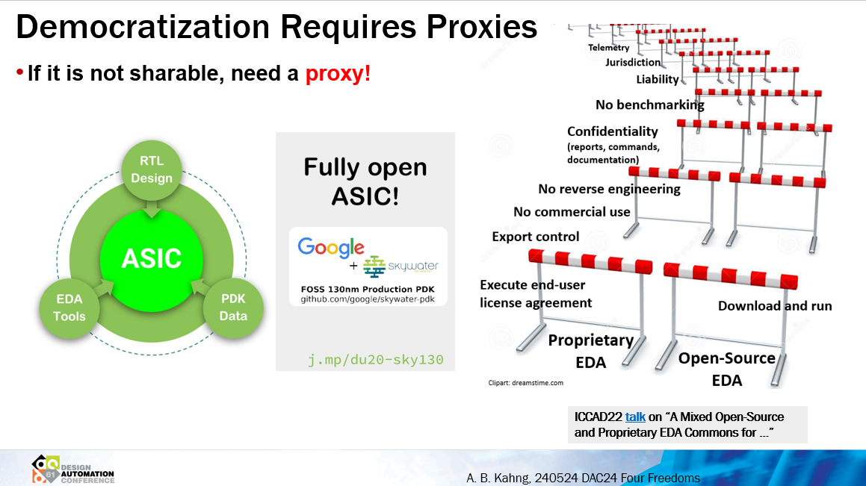
A Call to Action: Must Develop “Proxies” “if it can’t be shared, need a proxy !”
Proprietary PDK (Process Design Kit) data
Commercial EDA End-User License Agreements
No benchmarking (!)
Copyrighted command language → Tower of Babel
report_timing, report_checks, report_timing_analysis, check_timing, …
Copyrighted report formats → more Tower of Babel
^ and v vs. r and f , *** vs. === , …
Can’t share/upload ML data or models!
Foundation Models will require Data, which will require Proxies !
Tech files, device models, “safe names”, design enablements / tool setups, sharable results and metrics, … (“journey of a thousand miles …”)
Notes:
But let me close this “DATA” piece of “Difficult and Different” with an observation, and a Call to Action. If something can’t be shared, then a PROXY is needed.
A concrete case in point: the outputs of design tools – even their documentation – cannot be shared at all !!!
Results cannot be compared in public: That’s “benchmarking”, which is forbidden by the end-user license agreement.
Command names are copyrighted, so to avoid infringement you see “report underscore timing” and “report underscore checks” and “check underscore timing” etcetera. Which is the “intentional Tower of Babel”. We see carets and vees and r’s and f’s when we just want to say “rise” and “fall”. The report formats are copyrighted as well. No uploading to OpenAI.
[CLICK] So I claim that what we aspire to – Democratization, the AI Flywheel, Data to build Foundation Models … – will require Proxies. And [CLICK] the aiming point is what I call “Data Virtual Reality”. Getting there is one of those thousand-mile journeys – that starts with materials and chemistry and physics.

Slide 22
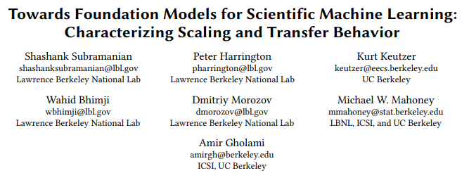
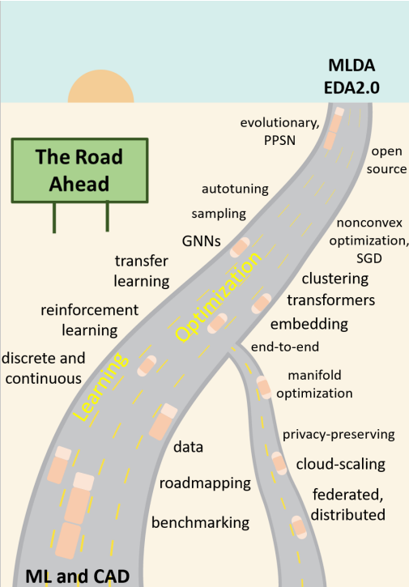
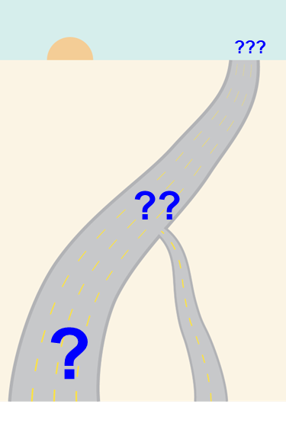
Er, EDA Foundation Models ?
Physics
Logic
Circuits
Multimodal
“ML for CAD/EDA”, 2020 talk, paper
“Foundation Models for CAD/EDA”, 202?
Notes:
Some years ago I wrote about a “Road Ahead” for the nexus of learning, optimization and CAD/EDA. [CLICK] It would be great to define and realize a “Road Ahead” for physics foundation models in chip design.

Slide 23
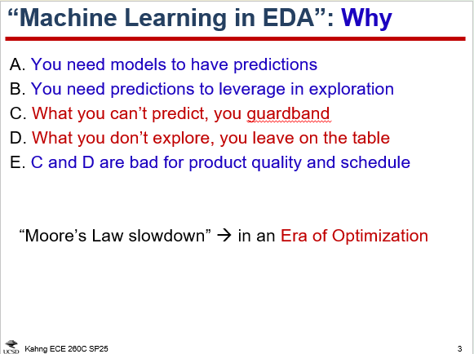
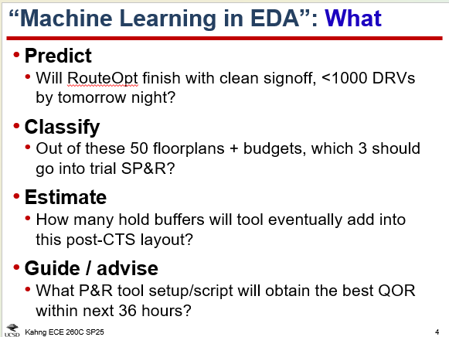
Possibilities With OpenROAD
Have seen examples in lectures …

Slide 24
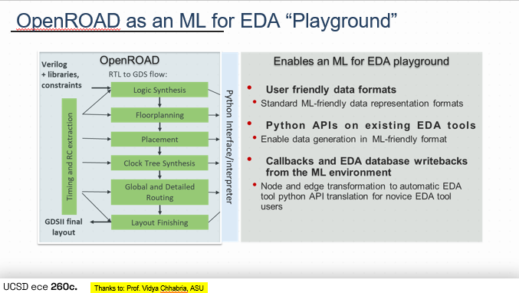
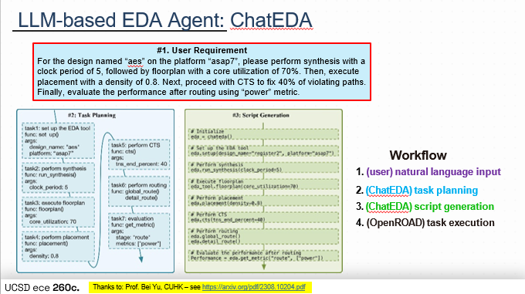
Examples: Lecture 1
Lecture 1: CircuitOps (ASU, Nvidia)
Lecture 1: ChatEDA (CUHK)
Kahng ECE 260C SP25

Slide 25


Examples: Lecture 1
Lecture 1: AutoTuner (UCSD)
Kahng ECE 260C SP25

Slide 26



Examples: Lecture 1
Lecture 1: METRICS (UCLA, UCSD)
Kahng ECE 260C SP25

Slide 27


Examples: Lecture 2
Lecture 2: The PDN Chicken-Egg (Arm, UMN, UCSD)
Critical cells want to be near each other. Supplying extra power to this hotspot will force the cells apart.
Can ML predict the “convergence point”?
(What can/should the flow do with such a prediction?)
Other examples: useful skew vs. synthesis; multi-bit FF clustering vs. place/opt; …
Kahng ECE 260C SP25

Slide 28


Examples: Lecture 13
Lecture 13: BlobPlace (UCSD, POSTECH)
Kahng ECE 260C SP25

Slide 29


Examples: Lectures 7, 15
Lectures 7, 15: Pin Access (UCSD)
Kahng ECE 260C SP25

Slide 30


Examples: Lecture 12
Lecture 12: RCX Model Creation (Athena/Nefelus)
Kahng ECE 260C SP25

Slide 31
ML Target #1: “Virtual Buffering”
Motivation: Netlist changes during ERC fix, timing fix (+ MBFF clustering, CTS, scan stitch, hold fix, antenna fix, etc.) how many netlists are there during P&R ?!?
Topology changes require accesses to GPU memory → slowdown of GPU-accelerated placers
Goal: Predict future netlist changes, account for them during placement to avoid “buffer surprise”
E.g., pre-allocate space that will be used by buffers, upsizes
Theme: Prediction for Prevention (“doomed runs” etc.)
Comment 1: What is the ACCURACY requirement? E.g., costs of FP, FN
Comment 2: “Acting on a prediction changes what is being predicted, so BE CAREFUL WHAT YOU ASK FOR (from ML)” (“BCWYAF”)
Kahng ECE 260C SP25

Slide 32

ML Target #2: Placement Initialization
Analytical placement = nonlinear optimization, sensitive to initial solutions
Goal: reduce #iterations, improve placement QoR
Theme: ML for Warm Start e.g., as in BlobPlace’s seeded blob placement
Comment 1: What are challenges? representation, embedding, model architecture, training, scalability, generalization (transfer, fine-tuning, …) across designs and technologies, data
Kahng ECE 260C SP25

Slide 33

ML Target #3: Handoffs at Interstices
Co-evolutions, Co-optimizations are often at arm’s length
Interstices = opportunities for “Conditioning Magic” via ML
Netlist Tomography
Placement Tomography
Themes: Initialization, TAT, Sampling from Chaos to Autotuning + Modern Compute (cloud, multicore)
Comment 1: Key concept = “Tomography”
ISPD-2024 paper, slides
Kahng ECE 260C SP25
Notes:
Over the years, I’ve talked about co-evolutions and co-optimizations, and I’ve also talked about ML “target lists” – including “magic” density screens or netlists. Like, there’s ONE netlist that comes into P&R – how can ML help us find “the magic netlist”?
The biggest opportunities for “magic” lie in what I call conditioning at the “arm’s length” interstices between flow stages and steps.

Slide 34
Concept of “Tomography”
Tomography = multiple cross-sectional views of a solid object
IDEA: Use many quick tool (GPU, proxy) runs and parallel execution to extract multiple views/reports in one unit of time
SP&R Flow
RTL Tomography: Multiple synthesis runs for quick RLT analysis and synthesis knobs tuning
RTL
Synthesis
Netlist Tomography: Multiple placement runs for quick netlist analysis and placement knobs tuning
Placement
Placement Tomography:
Multiple early global routing runs for rapid placement congestion analysis and routing‐blockage tuning
CTS
Route
Kahng ECE 260C SP25

Slide 35


Placement Tomography (ICCAD24) Link
Placement Tomography: Use routing blockage with varying routing‑resource values → generate multiple congestion views
ICCAD24 method has three main elements
DRVNet model: predicts layer-wise DRV hotspots
BlkgComp model: compares two routing blockage configurations
RL Agent: uses DRVNet, BlkgComp to sample routing blockages for #DRVs mitigation
Kahng ECE 260C SP25

Slide 36


Can Also Try Netlist or RTL Tomography!
Multiple views of a netlist
Slightly perturb the floorplan or SDC
Run each through place or placeopt
Analyze placement runs
Instances in congested regions
Failing endpoints
Set available placement knobs
Placement blockage
Cell padding
Soft guides
…
How about RTL tomography?
NOVA GF12
CA53 GF12
Kahng ECE 260C SP25

Slide 37





ML Target #4: Evolution in Optimizers
Example/Observation: global routing solution (route guides) sets the detailed router’s initial solution space
Can we create “good” GR solutions from “not-good” solutions?
UCSD “genetic / adaptive multi-start metaheuristic” using patching-based hybridization
Post-Route #DRCs Distribution
ISPD19_test5
Gen 11
Gen 6
50 GR seeds x 5 DR seeds
#DRCs
AMS, CAMS
Theme: “Parallel Problem Solving from Nature” Learn-to-Optimize, Adaptive Learning, Multi-fidelity BO, Evolutionary Optimization, Reinforcement Learning, … (+ metaheuristics)
Kahng ECE 260C SP25
Notes:
We’ve recently had a great success reducing DRCs at the end of final routing. The key insight is that in modern tools, the global routing solution restricts the detailed router's solution space. We asked the question: “Can we systematically create “good” GR solutions from ”not-good” solutions?”.
The answer is YES in OpenROAD, because we have an exposed handoff between GR and DR. The answer is NO if you use a commercial tool, because the vendor doesn’t expose any global route API to the user.
Our method systematically patches a problematic hotspot of an otherwise good global routing solutions using pieces of other global routing solutions. We also apply a genetic or “adaptive multi-start” framework. So:
[click] [click] [click] the hybridization shifts the distribution of DRC counts to the left over the generations. By this generation we have found very robust GR solutions that “always” lead to 0 DRCs in the detailed router.
[CLICK] Here’s another view showing that the distribution of routed wirelength vs. DRCs, and how the genetic metaheuristic converges. And if I rotate this last picture by 90 degrees …

Slide 38


ML Target #5: “The Analog Hole”
Field solvers, golden tools, patterns, … Can we skip this?
Idea: build OpenRCX table from massive post-P&R def, spef
Theme: “It’s Just Physics” could mean “No More Secrets” !!!
Comment 1: There is massive data in standard tool reports, outputs
Comment 2: ML can help “bypass” PDK data for material, device, BEOL …
Kahng ECE 260C SP25

Slide 39
AI, ML (+ OpenROAD): Some Takeaways
What’s Different (and Difficult)
Layers of hierarchy, abstractions and boundaries in any given instance of “design problem”
“Construct by correction” in chained chaotic, discrete (+ high-stakes) optimization (how to use predictions?)
Extreme multiscale in space, time
Infinite variety of possible layouts, shapes, constraints, designs
Data is unavailable → proxies needed (+ privacy-preservation, obfuscation, trust/verification etc.)
Many Opportunities
Full-stack proxy data generation will unblock many next steps ! (“#1 with a bullet”)
“Stubs and supports” for physical modeling and design of digital twins, 3D heterogeneous integration
Fast and accurate optimization of multiphysics behavior without detailed PDE simulations
Leverage datasets, insights, models developed for other engineering and design domains?
Pathfinding (from materials to systems) into the “beyond-everything” future
[Opportunities in RTL-to-GDSII: see Lecture Slides, Example ML Targets, and Themes!]
Trajectories of Connecting Silos
Materials + Mechanical sciences + EE/CS + Optimization + AI
Electrical-Thermal → Mechanical → Aging/Reliability/Noise → …
Digital (HW + SW) → Analog → Mechanical → (hydraulic, thermal, magnetic, fluidic) → …
Kahng ECE 260C SP25
Notes:
In conclusion: First, semiconductor design IS different and difficult. I’d highlight the LAYERS and BOUNDARIES of hierarchy and abstraction; the discrete and practical optimization centricity of sequential decision-taking; extreme scale and diversity; and there is no data.
[CLICK] Here are opportunities – full-stack proxy data; pathfinding the beyond-everything future of 2D and quantum materials; stubs and supports for digital twins and 3D (heterogeneous) integration.
[CLICK] And some trajectories of how silos will need to be connected up. Which is why we’re here.

